Slide 1
Students' performance analysis
Depi presentation

Slide 2
Layout
Introduction
Hypothesis
Data preprocessing
Calculation correlation
Data visualization

Slide 3
Introduction
The dataset contains student grading information, including scores, attendance, study habits, and socioeconomic factors. This code cleans and preprocesses the data by handling missing values and encoding categorical features. It then performs exploratory data analysis (EDA) using statistical methods and visualizations to identify trends, correlations, and patterns in student performance. The analysis helps uncover key factors affecting academic success.

Slide 4
Data preprocessing
First and most important step is cleaning data and Handle missing values.
STEP1: REMOVING UNNCESSERY COLUMNS
Student ID, First Name, Last Name, and Email columns
because it will not mean any thing.

Slide 5


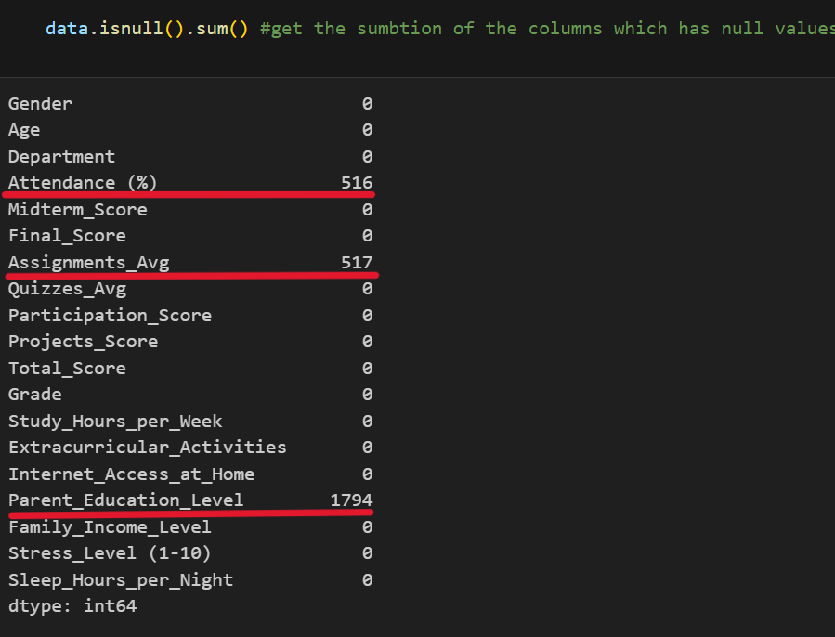
Step2: HANDLING MISSING VALUES
There is missing values at Attendance, Assignments, and Parent_Education_Level.
Attendance and Assignments got replaced by the mean because they are numerical values
Parent_Education_Level is a categorical data let’s replace it by the mode but that’s seems wrong due to 36% of the data is missing and the mode was PhD and that’s not common between people.
It’s better to set it as random value from the domain of the data.

Slide 6
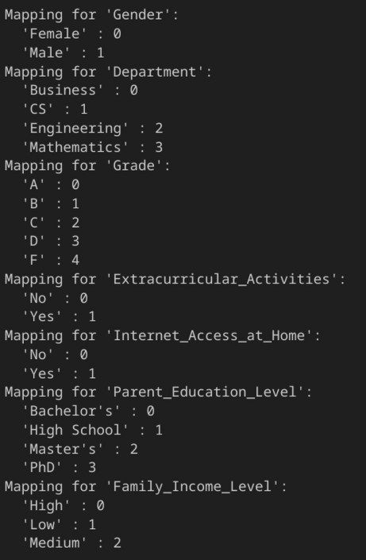
Step 3: transforming categorical data
After ensuring there are no missing values, removing duplicates, and verifying that each column has the correct data type, we transform categorical data into numerical values to calculate the correlation.
Get copy of the data
Using the scikit-learn module's encoder function, we get the unique values from each column, arrange them alphabetically, and assign the first value to 0, the second to 1, and so on.

Slide 7
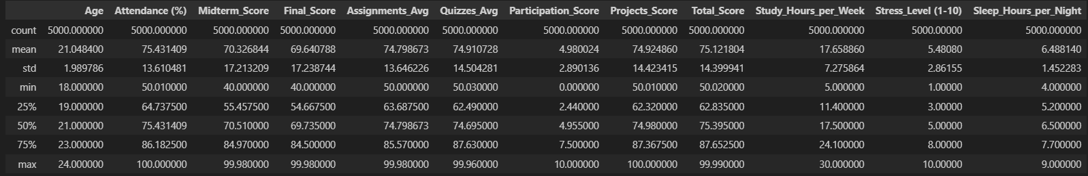
Step4: Handle outliers
The data appears to be normally distributed. The Interquartile Range (IQR), mean, and standard deviation are well-balanced, indicating that outliers are not significantly impacting the dataset. Therefore, no additional handling of outliers is necessary.

Slide 8
Calculating the correlation
After cleaning and transforming the data, it's time to calculate the correlation.
Correlation measures the relationship between columns, helping us identify patterns and dependencies. This analysis provides key insights and serves as the foundation for testing our hypothesis.

Slide 9
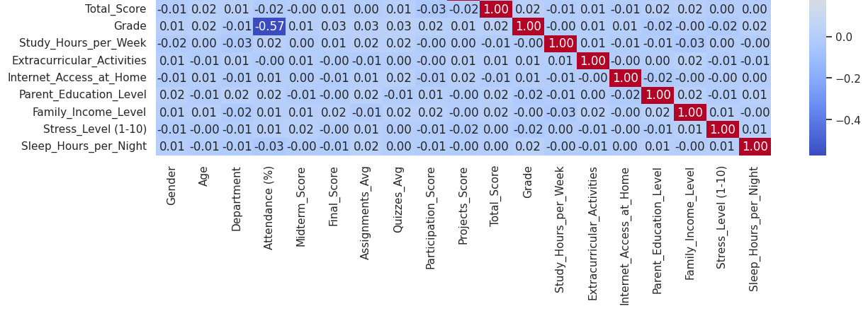
The correlation analysis shows a weak or no relationship between total score and other variables, indicating that total score is not significantly influenced by any specific factor in the dataset.
Similarly, grade also exhibits weak correlation with other features, suggesting that it remains largely independent of most variables. However, attendance shows some correlation, implying that student attendance may have a slight impact on grades.
That’s make the answer to our hypothesis is NO there isn’t something has influence on total score.

Slide 10
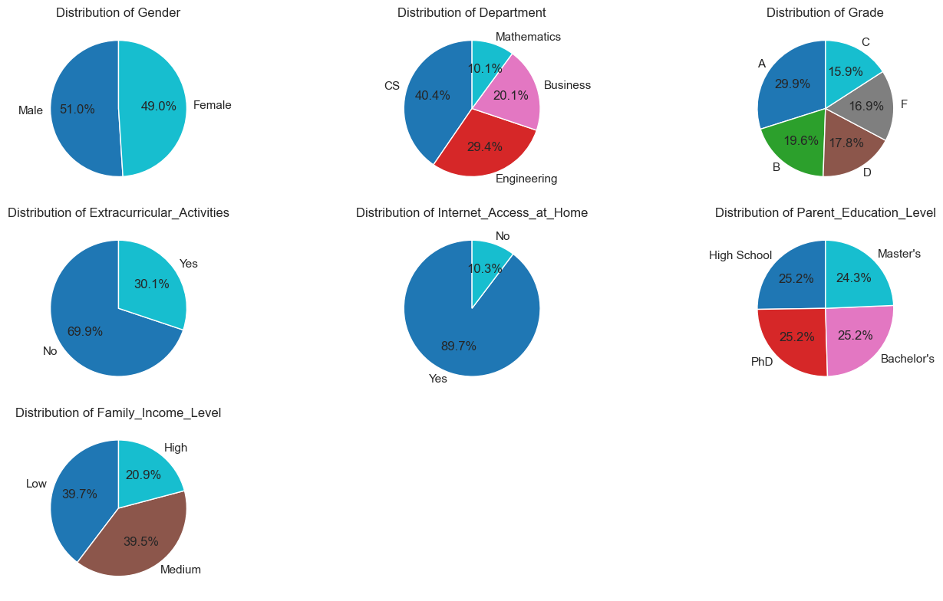
Data visualization
Distribution of all columns

Slide 11
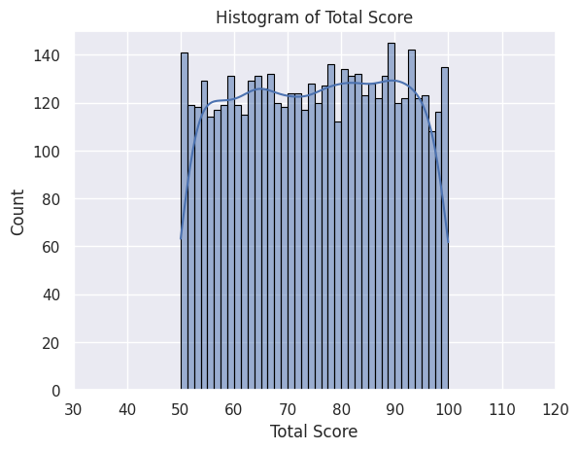
Total score Distribution: its close enough to bill graph

Slide 12
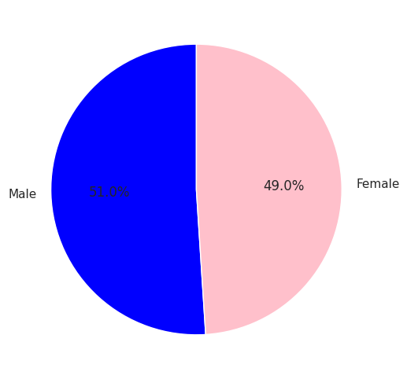
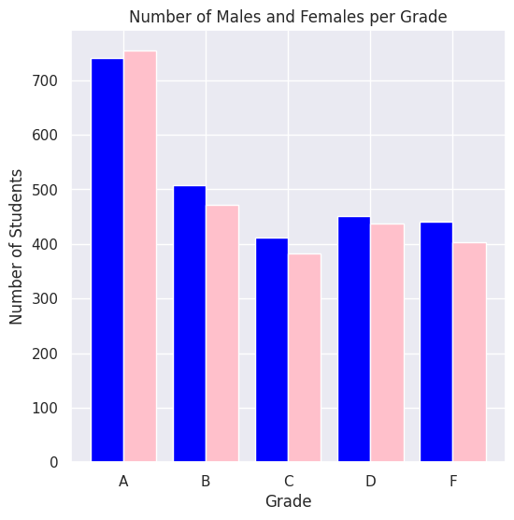
Hypothesis 1: Which Gender Get Better grades – Males or Females?
Despite males being 1% more in number, females receive more A grades, while males dominate other grade categories. We could say most of females attendance more.

Slide 13
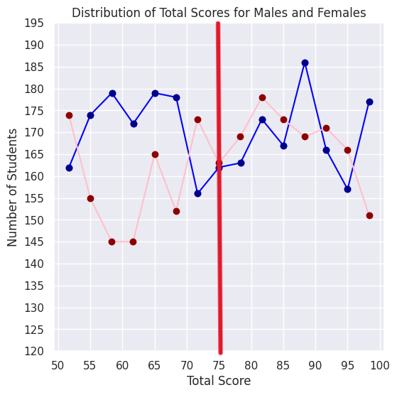
Hypothesis 1: Which Gender Scores Better – Males or Females?
After dividing the graph form the middle it shows males average score from 50 to 75
On other hand most of females score from 75 to 100

Slide 14
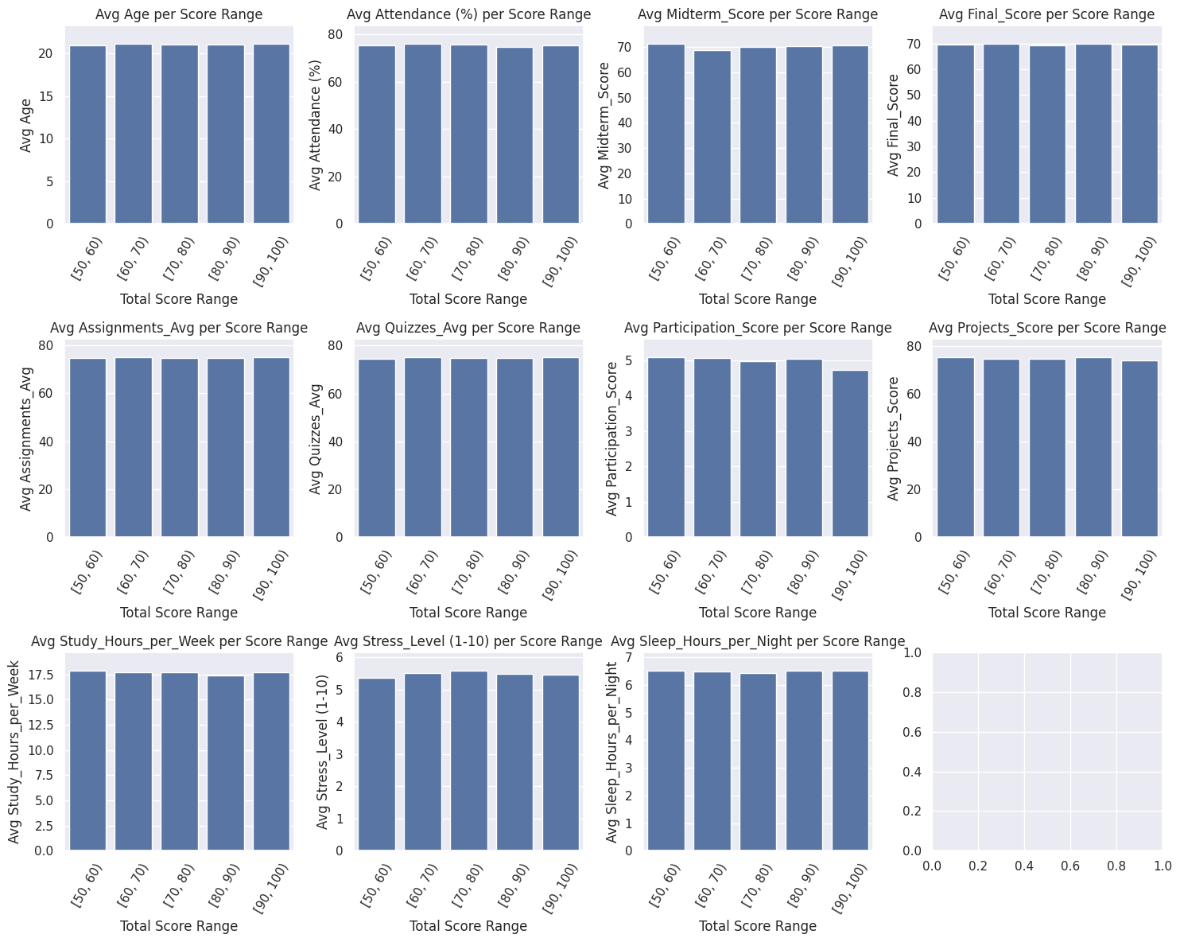
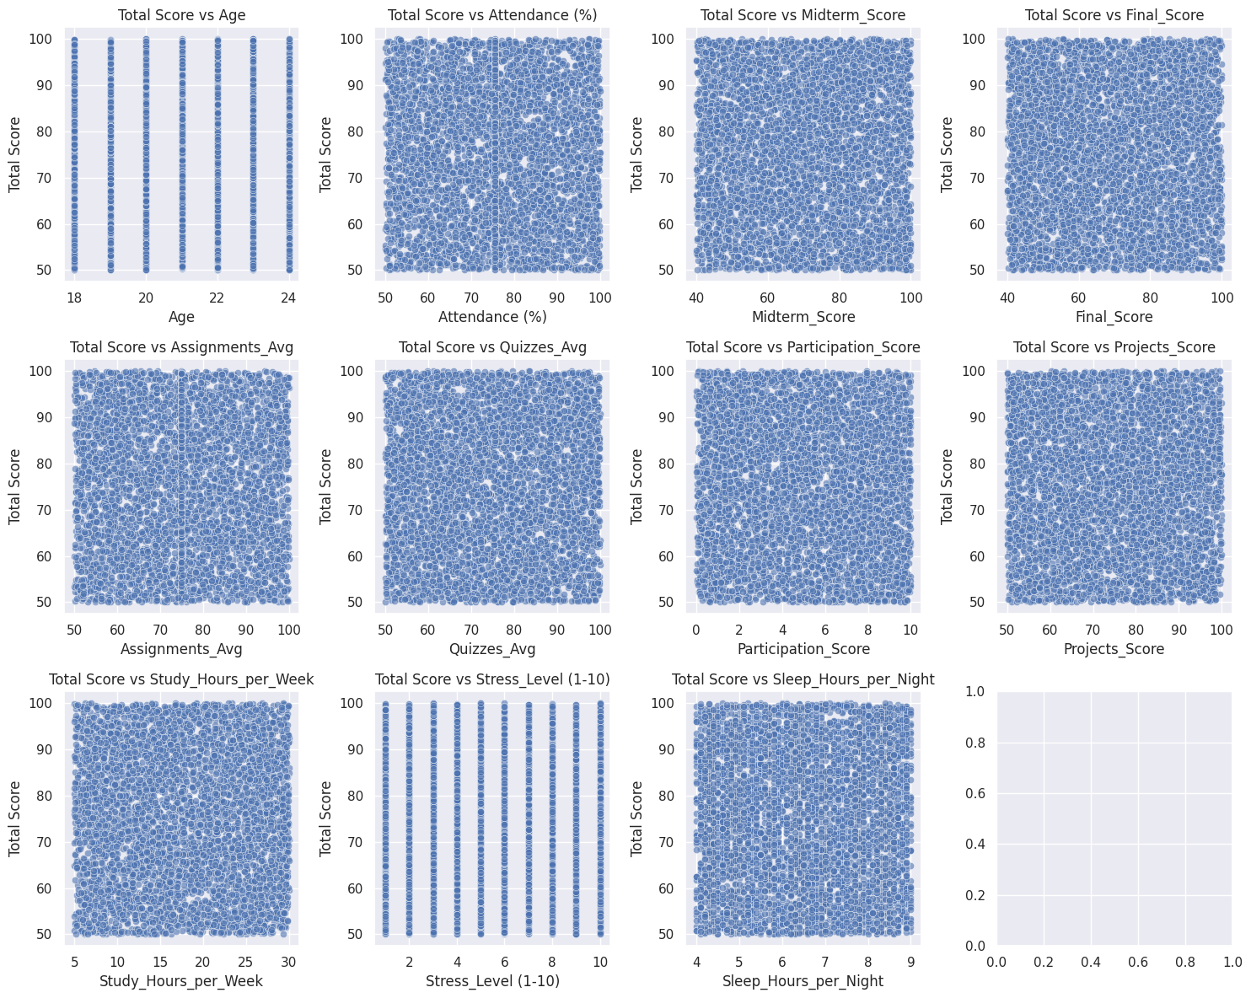
Total score to other columns that’s ensure the fact of there isn’t any correlation

Slide 15
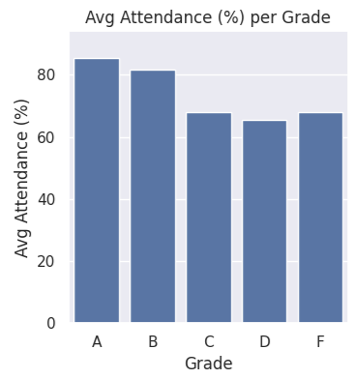
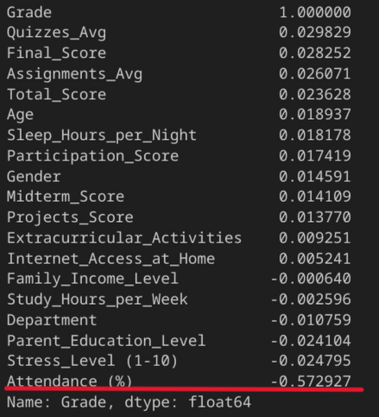
Hypothesis2: which is affecting grade?
According to the correlation matrix grade is affected by attendance and this graph ensures this fact
Notes:
Negative cuz encoder

